Slide 1
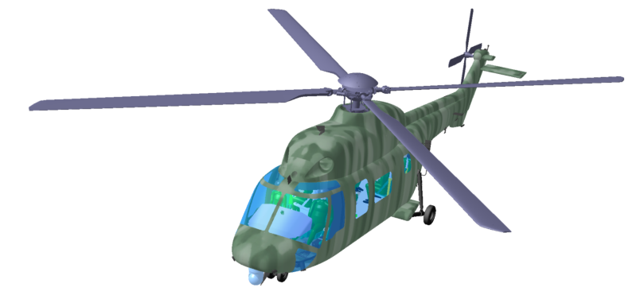
Numerical Analysis
10 Review on the First Part

Slide 2

Scope in Lecture Plan
Weekly Plan
Week | Subject
1 | Introduction to the Lecture
2 | Numerical accuracy (1) | 수치오차
3 | Numerical accuracy (2) | 수치오차
4 | Nonlinear algebraic equation (1) | 비선형 대수방정식
5 | Nonlinear algebraic equation (2) | 비선형 대수방정식
6 | Roots of polynomial equations | 다항식의 근
7 | Linear algebraic equation (1) | 선형 대수방정식
8 | Midterm exam
9 | Linear algebraic equation (2)/Optimization | 선형 대수방정식 / 최적화 기법
10 | Curve-fitting Techniques (1): least Square Regression | 최소 자승법
11 | Curve-fitting Techniques (2): Interpolation | 보간법
12 | Numerical integration (1) | 수치 적분
13 | Numerical integration (2) | Gauss 적분법
14 | Numerical methods for ordinary differential equations (1) | 상미분방정식 수치해법
15 | Numerical methods for ordinary differential equations (2) | 상미분방정식 수치해법
16 | Final Exam

Slide 3
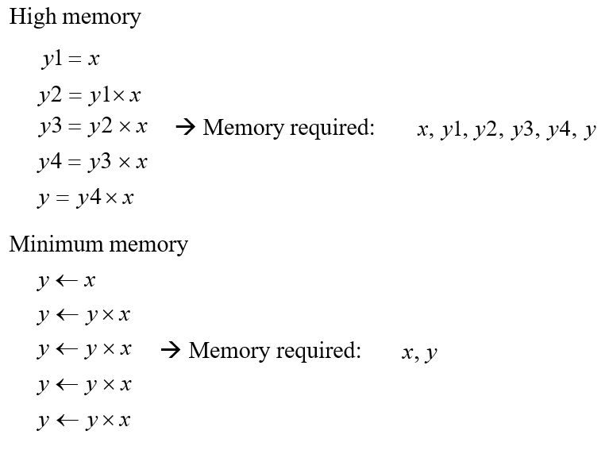
How to develop Efficient Numerical Analysis Algorithms
Memory Saving
Saving CPU time for
Algorithm I: Naïve Approach
Algorithm II: Efficient Approach

Slide 4
How to develop Efficient Numerical Analysis Algorithms
Saving CPU time for
Algorithm I: Naïve Approach
Algorithm II: Efficient Approach

Slide 5
How to develop Efficient Numerical Analysis Algorithms
Saving CPU time for
Algorithm I: Naïve Approach
Algorithm II: Efficient Approach

Slide 6
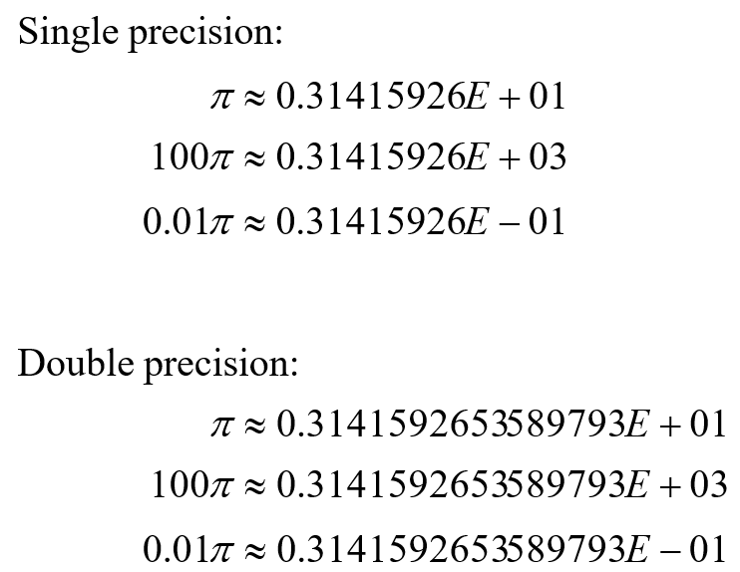
Lecture Plan
Numerical Error
Type of Errors
- Round off Error
- Truncation Error
Round off Errors

Slide 7
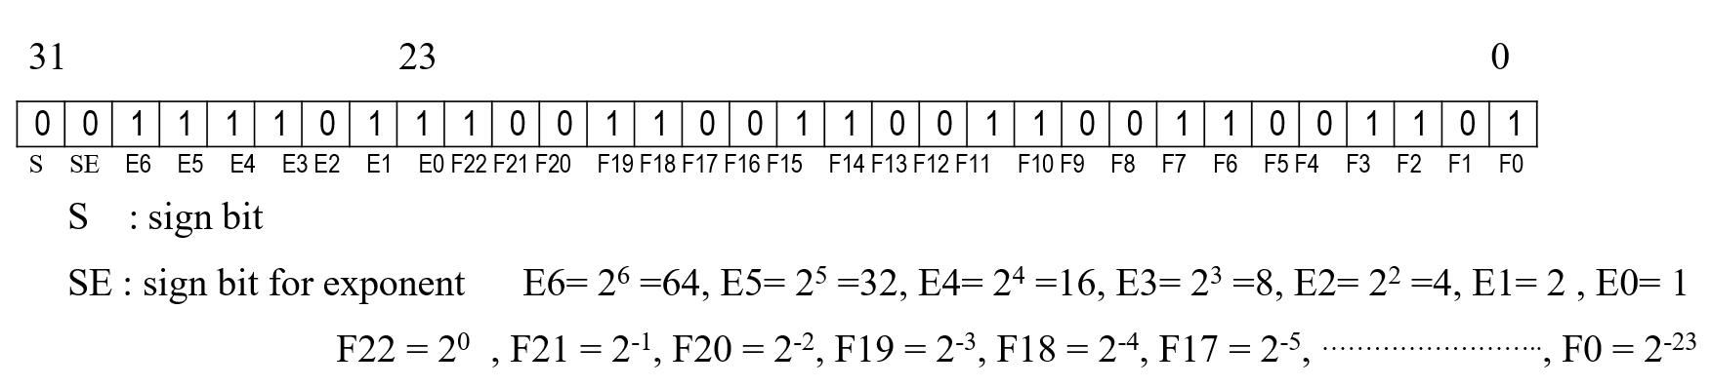
Numerical Error
Round off Errors
IEEE 754 format for 1 32-bit float real data type in 32-bit precision
- sign 1bit, exponent: 8bits, fraction: 23 bits

Slide 8
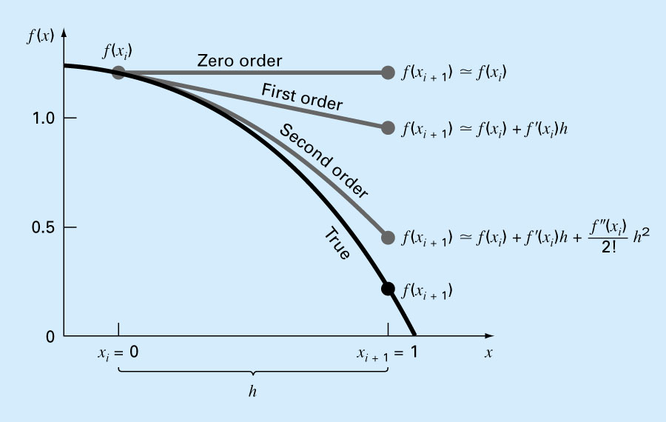
Numerical Error
Truncation Errors
zero order
1st order
2nd order
3rd order

Slide 9
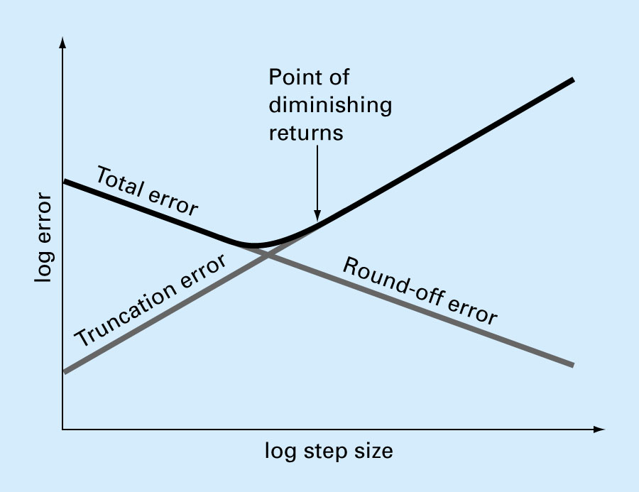
Numerical Error
Total Error
How to reduce Total Error
- Round-off error: by using double precision using IEEE data format
→ You should declare the type of data (single or double) regardless of the
computing machine (32-bit or 64-bit machines)
- Truncation error: By using higher order approximation
By using smaller step size
Etc.
→ limited by computer speed

Slide 10
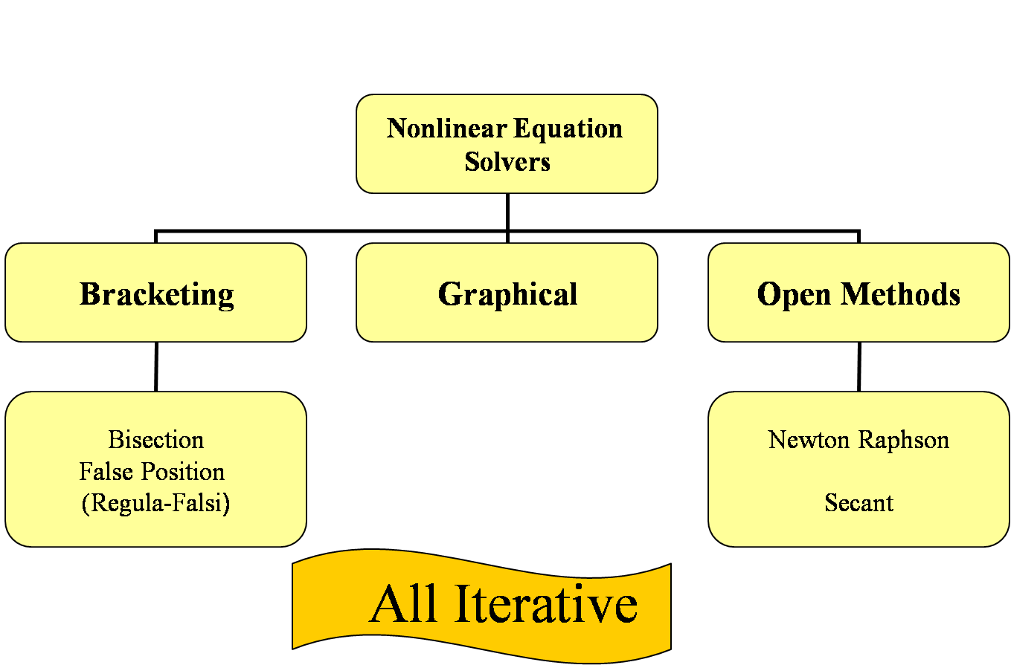
Roots of Equations
Problem Statements
Available Methods

Slide 11
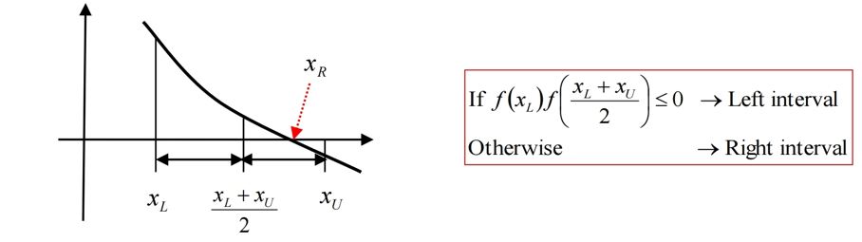
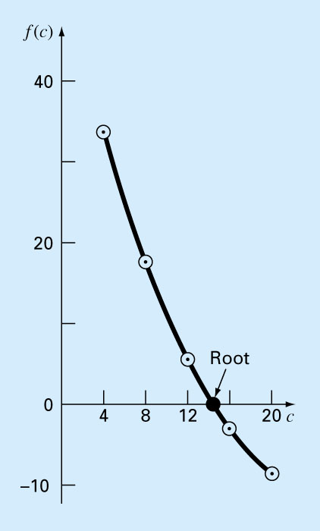
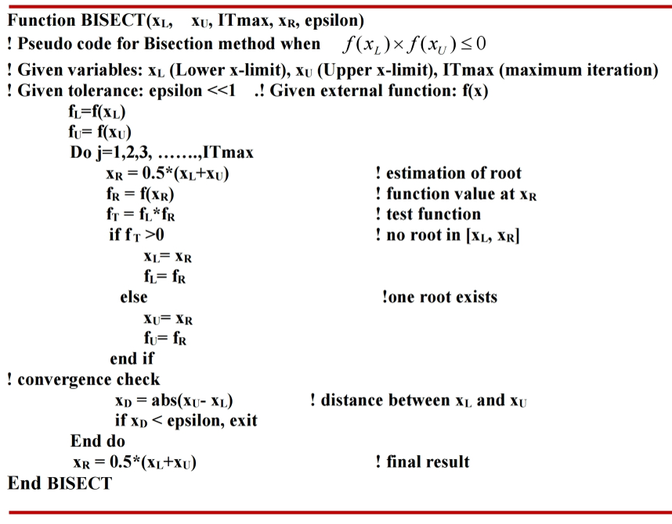
Roots of Equations
Bracketing Method with the Interval Halving Algorithm
Existence of one root
Interval-Halving (Bisection) Algorithm

Slide 12
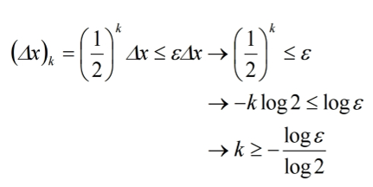
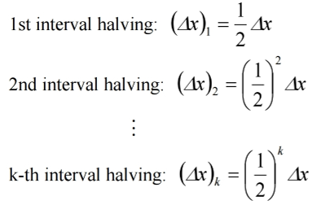
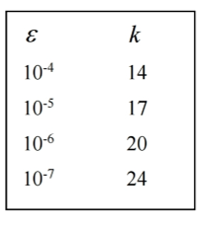
Roots of Equations
Bracketing Method with the Interval Halving Algorithm
Convergence of the Bracketing Method

Slide 13
Roots of Equations
Newton-Raphson Method
Problem Statement
Jacobian Matrix
First order Approximation for (j+1) iterative solution
Iterative solution with Under-Relaxation Factor

Slide 14
Roots of Equations
Newton-Raphson Method
Example Evaluation of Jacobian Matrix
Numerical Approximation of Jacobian Matrix

Slide 15
Roots of Polynomial Equations
Problem Statement: All coefficients “a”s are real
Polynomial Deflation
Finding two roots using Quotient

Slide 16
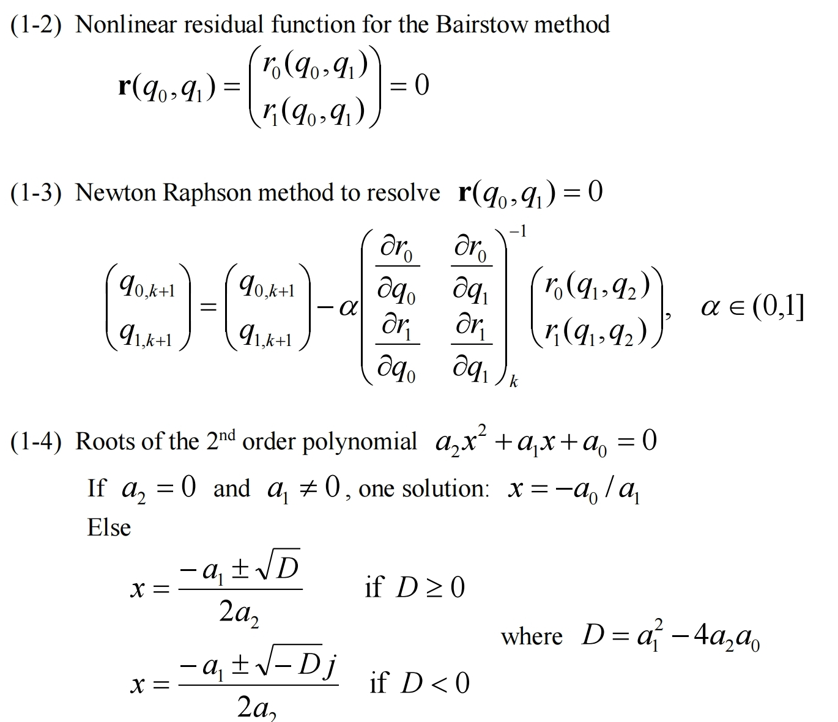
Roots of Polynomial Equations
Bairstow’s Algorithm

Slide 17
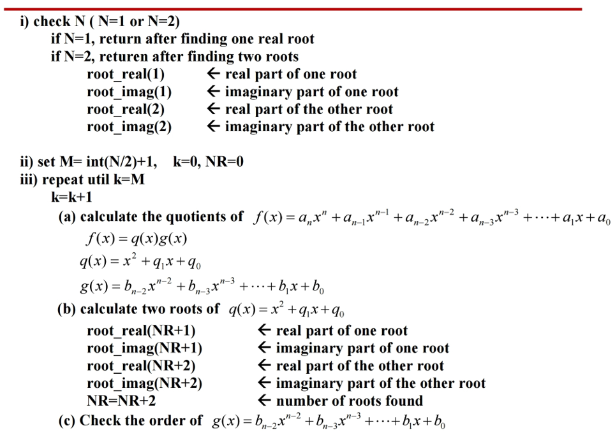
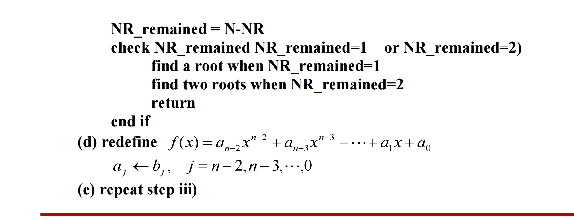
Bairstow’s
Algorithm

Slide 18
Linear Algebraic Equation
Problem Statement

Slide 19
Linear Algebraic Equation
Gauss Elimination Method to get
Back Substitution method for Upper Triangular System

Slide 20
Linear Algebraic Equation
LU-Decomposition

Slide 21
Linear Algebraic Equation
LU-Decomposition

Slide 22
Linear Algebraic Equation
Matrix Inverse

Slide 23
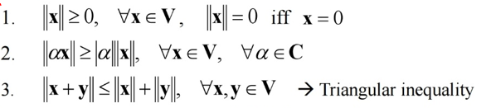
Linear Algebraic Equation
Vector Norm
P-norm
1-norm (p=1)
2-norm (p=2)
infinite-norm

Slide 24
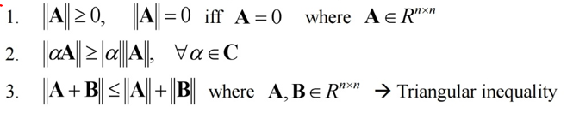
Linear Algebraic Equation
Matrix Norm
Subordinate Matrix Norm
Eigenvalue problem
Matrix Condition Number

Slide 25
Linear Algebraic Equation
Error Dependency on Matrix Condition Number

Slide 26
Optimization Algorithm
Problem Statement
: cost function (or objective function)
: inequality constraint
: equality constraint
: design variables
: number of inequality constraints
: number of equality constraints
: number of design variables

Slide 27
Optimization Algorithm
First-order Optimality Condition for Unconstrained Problem
Approximation around the optimal design variables
First Order Optimality Condition

Slide 28
End of Lecture

